Slide 1
Diabetes Prediction

Slide 2

Agenda
Table of Contents
I
II
Ensemble Techniques
III
Methodology
IV
Results
V
Power BI Report
VI
Conclusion

Slide 3

I
Agenda
Diabetes is easier to treat when it is detected in the early stages. Machine learning techniques may aid a more efficient analysis in the prediction of the disease. Moreover, this prediction is one of the most central problems in medicine, as it is one of the leading diseases related to an unhealthy lifestyle. So, an early prediction of this disease will be useful for a cure or aversion.
In this study, we experiment with the diabetes dataset to explore the machine learning algorithms and build an optimum model to predict the disease.
And to use ensemble techniques to improve the efficiency

Slide 4
The data required for the prediction of diabetes has been collected from various sources. These data have been segregated into rows and columns of a table.
I
Data

Slide 5
1) id
I
Data Definition
BMI
DiabetesPedigreeFunction
Age
Blurry vision
Weight loss
Numbness
Urinating often
Thirsty
Outcome
Phone_no
District
Gender
Cholesterol
Glucose
Blood Pressure
Skin Thickness
Insulin

Slide 6

These are techniques that create multiple models and then combine them to produce improved results. Ensemble methods usually produce more accurate solutions than a single model would.
II
Ensemble Techniques
Techniques:
Bagging Meta-estimator
AdaBoost
XGBM

Slide 7

II
Bagging Meta-estimator
A Bagging classifier is an ensemble meta-estimator that fits base classifiers each on random subsets of the original dataset and then aggregates their predictions (either by voting or by averaging) to form a final prediction. Such a meta-estimator can typically be used as a way to reduce the variance of a black-box estimator (e.g., a decision tree), by introducing randomization into its construction procedure and then making an ensemble out of it.

Slide 8

II
AdaBoost
The AdaBoost classifier is a meta-estimator that begins by fitting a classifier on the original dataset and then fits additional copies of the classifier on the same dataset but where the weights of incorrectly classified instances are adjusted such that subsequent classifiers focus more on difficult cases.

Slide 9
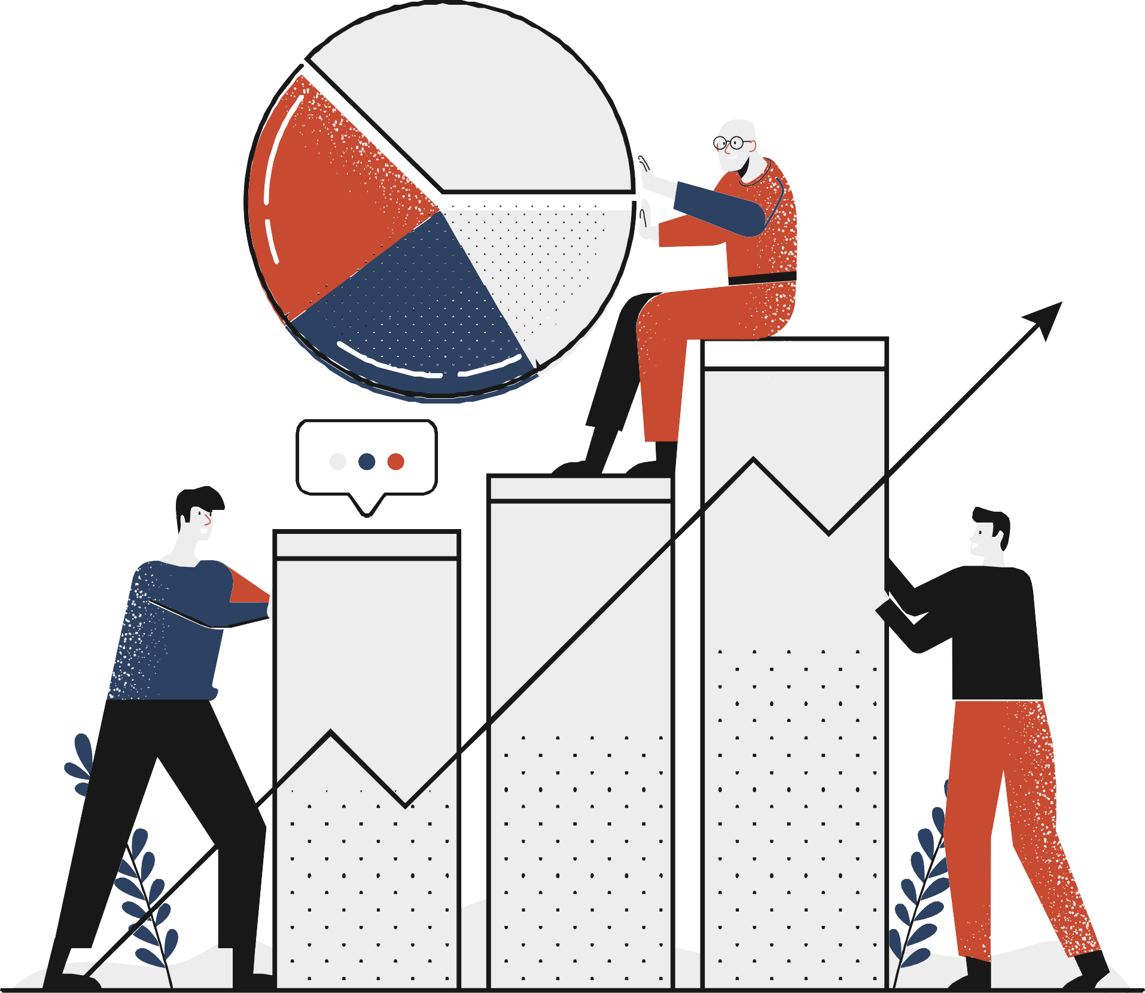
1. Data Analysis and Preparation
III
Methodology
Balancing of Data
Feature Selection
Ensemble Techniques

Slide 10
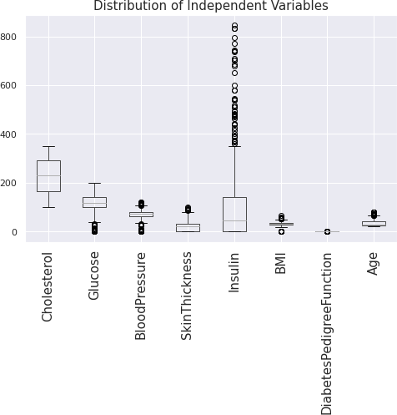

- Discover Outlier
III
1. Data Analysis and Preparation
Missing Values
Duplicates

Slide 11
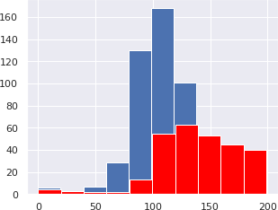
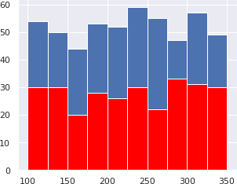
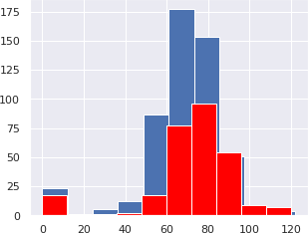
III
Visualization of Data
BloodPressure

Slide 12
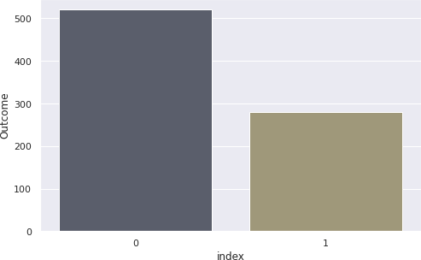
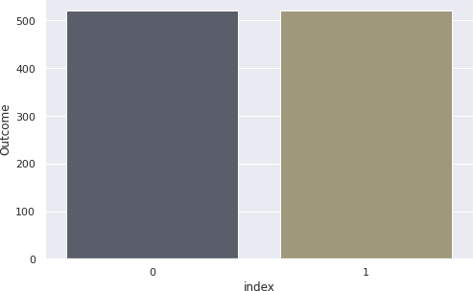
Synthetic Minority Oversampling Technique(SMOTE)
III
2. Balancing of Data
It is one of the most commonly used oversampling methods to solve the imbalance problem.
It aims to balance class distribution by randomly increasing minority class examples by replicating them.
It generates the virtual training records by linear interpolation for the minority class.
These synthetic training records are generated by randomly selecting one or more of the k- nearest neighbors for each example in the minority class.

Slide 13
Models
III
3. Feature Selection
Logistic Regression: It is a statistical model that models the probability of one event (out of two alternatives) taking place by having the log-odds (the logarithm of the odds) for the event be a linear combination of one or more independent variables ("predictors").
Decision Tree Classifier: It is a non-parametric supervised learning method used for classification and regression. The goal is to create a model that predicts the value of a target variable by learning simple decision rules inferred from the data features. A tree can be seen as a piecewise constant approximation.
Random Forest Classifier: It is a meta estimator that fits a number of decision tree classifiers on various sub-samples of the dataset and uses averaging to improve the predictive accuracy and control over- fitting.

Slide 14
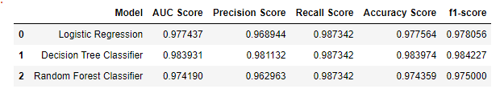
III
4. Ensemble Techniques
These techniques are used for the model which has the highest accuracy in the prediction of the target values.
Techniques:
Bagging Meta-estimator
AdaBoost

Slide 15
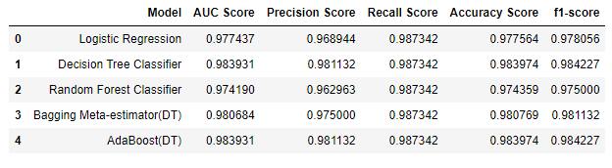
IV
Results
From the above table, we can say that the ensemble techniques are used for the Decision Tree Classifier which has the highest accuracy score for prediction.

Slide 16
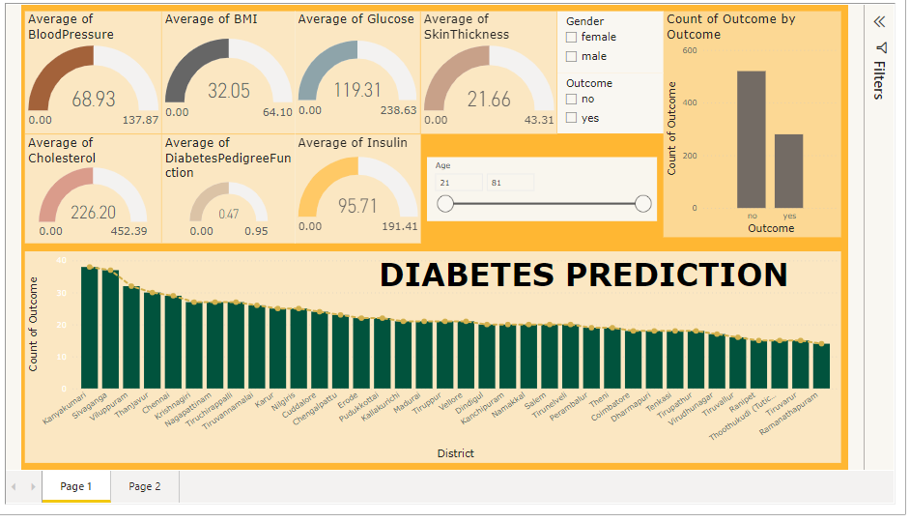
V
Power BI Report

Slide 17

VI
Conclusion & Discussions
Improvements
Scope
The scope of this project is in the medical field .
Applications
It can be used in hospitals and clinics.
It can be used for surveys and data analysis to improve the treatment methods.
Automatic collection of data from the medical equipment.
We can visualize and analyze the data using Tableau and Power BI
17

